Slide 1

NLP Challenges
in the film "Arrival"
This presentation explores how the movie "Arrival" (2016) reflects challenges in Natural Language Processing. The film focuses on language and communication as central themes. It provides a unique lens to examine real-world NLP problems and potential solutions.
prepared by
Fast Jet Learning Rockets Team (FJLR)

Slide 2


Ambiguity in Language
Misinterpretation
Multiple Meanings
Understanding intent can be challenging.
Context is crucial for accurate interpretation.

Slide 3




Idiomatic Expressions
Human idioms like "Break a leg" are difficult for NLP to interpret literally.
Deep learning models (BERT, GPT) improve contextual understanding of idioms.
Rule-based NLP models struggle with idioms because they are not literal.

Slide 4



Sarcasm and Context
Tone and Context
Detecting Sarcasm
Human communication relies heavily on tone to convey meaning.
Subtle cues make sarcasm a challenge for NLP.

Slide 5




Cultural Variations
Unique Structures
Different languages have unique structures and idioms.
Cross-Linguistic Nuances
NLP must consider cross-linguistic nuances for accurate translations.
NLP Applications
It is important to ensure accuracy in all NLP translation applications.

Slide 6
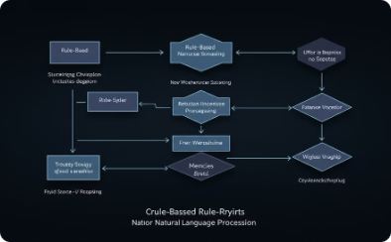
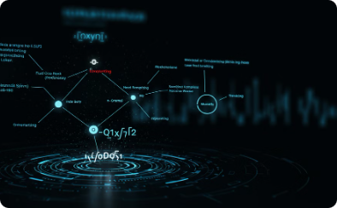


Method in the film "Arrival"
Rule-based NLP
Statistical NLP
Deep NLP
Contextual NLP
Early stages involve manually mapping symbols to meanings, similar to rule-based NLP
Recognizing repeating symbols is similar to n-gram models and probabilistic language models
Louise refines her understanding iteratively, like how transformers predict meaning
The Heptapods perceive time non-linearly, resembling transformer-based models that process text with full context

Slide 7

Deciphering Alien Language
1
Pattern Recognition
Scientists use pattern recognition and context learning to translate.
2
Statistical NLP
NLP uses Statistical and Deep NLP (Transformer models, embeddings) to translate new languages.
3
Machine learning
Learning through exposure and context, similar to machine learning-based NLP models.

Slide 8

Visualization & Representation
The film "Arrival" highlights the importance of visualization and representation in understanding complex concepts. The alien Heptapod language uses a circular writing system to convey entire sentences at once. NLP tools use vectorized meaning representations.

Slide 9
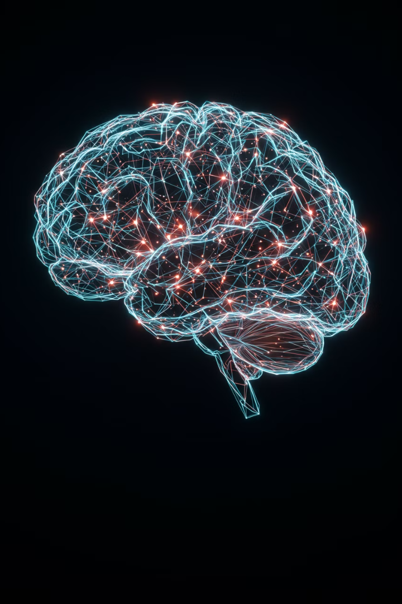
Lessons for NLP Development
The film "Arrival" highlights the complexities of communication and the challenges in NLP. The need for better models to interpret ambiguity is key. Future AI models should integrate multimodal data. This will lead to a richer understanding and improve accuracy.

